Slide 1
Poverty Alleviation
Designed by arshlan khan

Slide 2
Poverty alleviation refers to the efforts and strategies aimed at reducing or eliminating poverty, ensuring that individuals and communities have access to basic needs, opportunities, and resources for a dignified life. Poverty is not simply a lack of income; it encompasses broader dimensions such as inadequate access to education, healthcare, nutrition, clean water, and sanitation. Addressing poverty requires a holistic approach that focuses on both short-term relief and long-term solutions.

Slide 3
Understanding Poverty:
Poverty is typically measured by income levels, with those living below a certain income threshold considered poor. However, poverty also includes multidimensional factors like social exclusion, lack of opportunity, and vulnerability to shocks (e.g., natural disasters or economic crises). The United Nations defines poverty as the inability to access the resources needed to enjoy a decent standard of living, including the essential needs for health, education, and housing.

Slide 4
There are two main types of poverty:
Absolute Poverty: Living below the minimum income required to meet basic needs like food, shelter, and clothing.
Relative Poverty: Where people are considered poor in comparison to the general standard of living in society, even if they can meet basic needs.

Slide 5
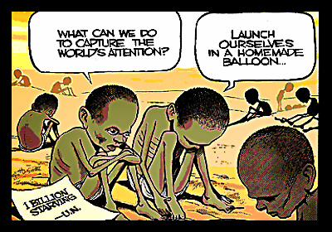
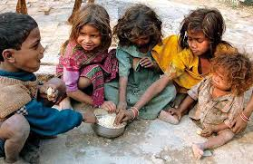
Difference with images
Absolute Poverty:
Relative Poverty:

Slide 6
Challenges to Poverty Alleviation:
Political Instability:
Climate Change:
Inequality:
Political corruption, instability, or conflict can disrupt poverty alleviation efforts and make it difficult to implement sustainable solutions
Environmental degradation, droughts, and floods are becoming more frequent, and their impact disproportionately affects the poorest communities, making poverty alleviation more difficult.
Socio-economic inequality, including gender inequality, racial discrimination, and regional disparities, often hinders efforts to reduce poverty effectively.

Slide 7
The Role of Individuals and Communities:
While governments and international organizations play a major role, individuals and communities can also contribute to poverty alleviation. Local initiatives that promote education, health, and sustainable livelihoods can have a significant impact at the grassroots level. Community-based organizations and movements often play an essential role in advocating for the rights of the poor and ensuring that poverty alleviation programs are effectively implemented.

Slide 8
conclusion
Poverty alleviation requires coordinated global and local efforts that tackle the root causes of poverty while also providing immediate relief. By focusing on inclusive economic growth, access to education and healthcare, social safety nets, and the empowerment of marginalized groups, poverty can be reduced, and eventually eradicated. However, this is only possible through sustained political will, community involvement, and international cooperation.

